Slide 1
Image Segmentation
Doaa Sherif
Salma Hazem
Yara Wael

Slide 2
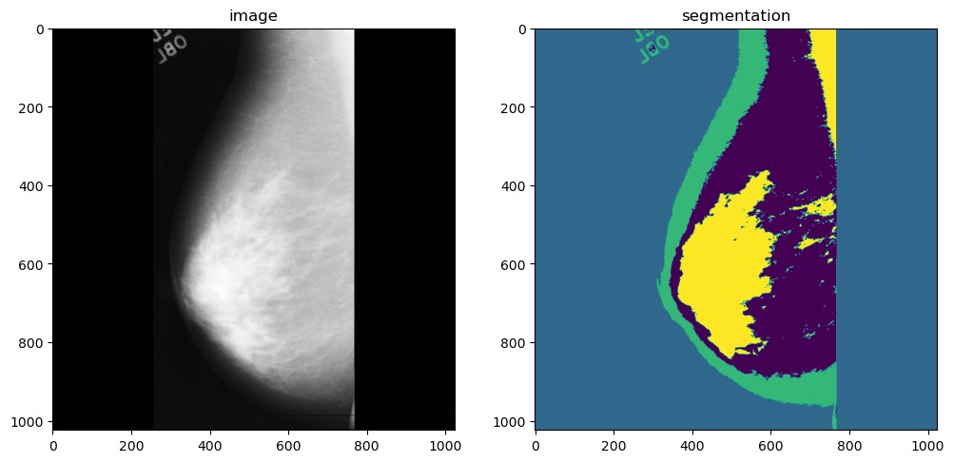
Problem Definition
Image Segmentation is the process by which a digital image is partitioned into various subgroups of pixels called Image Objects.

Slide 3
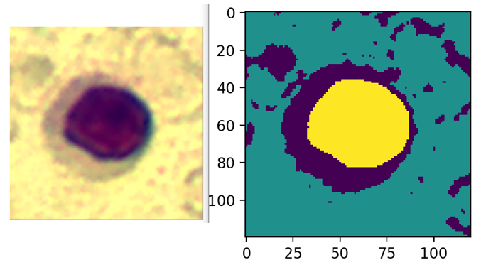
C-means Clustering

Slide 4
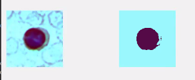
Shallow Neural Network

Slide 5
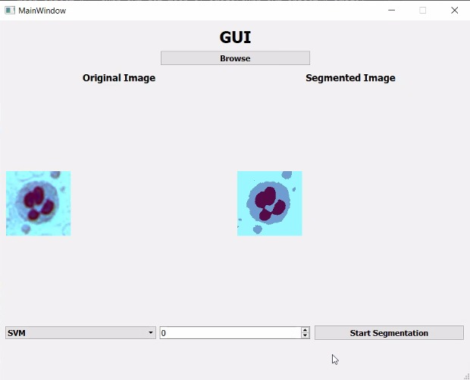
Support Vector Machine (SVM)

Slide 6
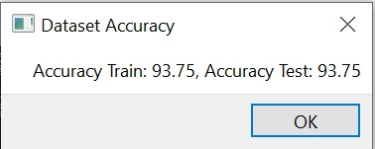
Dataset Accuracy

